Slide 2
Functional Dependencies and Normalization for Relational Databases

Slide 3
Outline
1 Informal Design Guidelines for Relational Databases
1.1Semantics of the Relation Attributes
1.2 Redundant Information in Tuples and Update Anomalies
1.3 Null Values in Tuples
1.4 Spurious Tuples
2 Functional Dependencies (FDs)
2.1 Definition of FD
2.2 Inference Rules for FDs
2.3 Equivalence of Sets of FDs
2.4 Minimal Sets of FDs

Slide 4
1 Informal Design Guidelines for Relational Databases (1)
What is relational database design?
The grouping of attributes to form "good" relation schemas
Two levels of relation schemas
The logical "user view" level
The storage "base relation" level
Design is concerned mainly with base relations
What are the criteria for "good" base relations?

Slide 5
1.1 Semantics of the Relation Attributes
GUIDELINE 1: Informally, each tuple in a relation should represent one entity or relationship instance. (Applies to individual relations and their attributes).
Attributes of different entities (EMPLOYEEs, DEPARTMENTs, PROJECTs) should not be mixed in the same relation
Only foreign keys should be used to refer to other entities
Entity and relationship attributes should be kept apart as much as possible.
Bottom Line: Design a schema that can be explained easily relation by relation. The semantics of attributes should be easy to interpret.

Slide 6
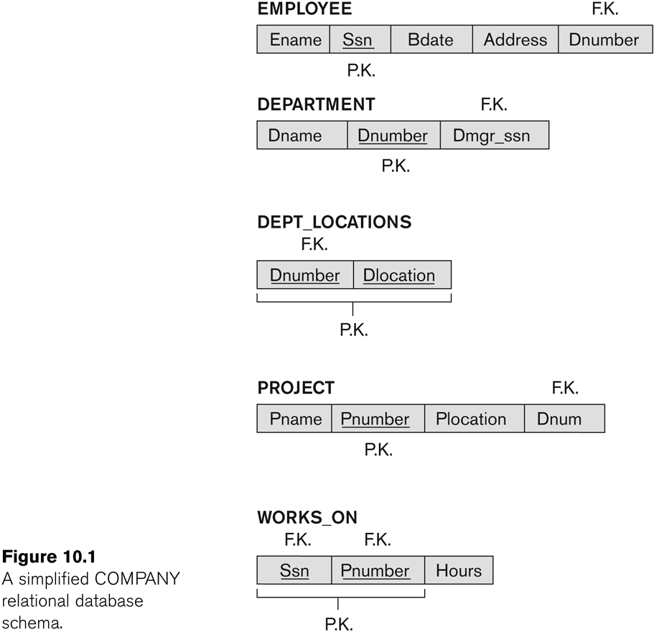
A simplified COMPANY relational database schema

Slide 7
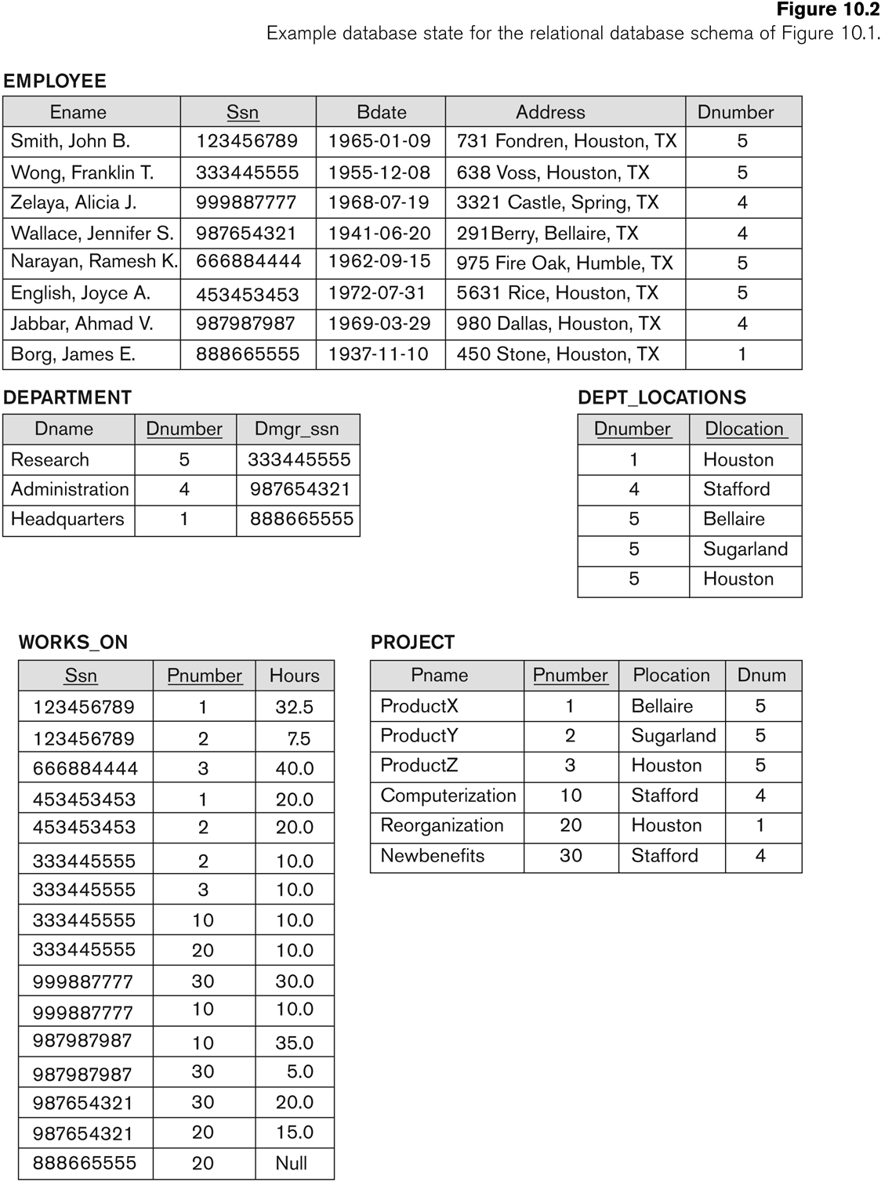

Slide 8
1.2 Redundant Information in Tuples and Update Anomalies
Information is stored redundantly
Wastes storage
Causes problems with update anomalies
Insertion anomalies
Deletion anomalies
Modification anomalies

Slide 9
EXAMPLE OF AN UPDATE ANOMALY
Consider the relation:
EMP_PROJ(Emp#, Proj#, Ename, Pname, No_hours)
Update Anomaly:
Changing the name of project number P1 from “Billing” to “Customer-Accounting” may cause this update to be made for all 100 employees working on project P1.

Slide 10
EXAMPLE OF AN INSERT ANOMALY
Consider the relation:
EMP_PROJ(Emp#, Proj#, Ename, Pname, No_hours)
Insert Anomaly:
Cannot insert a project unless an employee is assigned to it.
Conversely
Cannot insert an employee unless a he/she is assigned to a project.

Slide 11
EXAMPLE OF AN DELETE ANOMALY
Consider the relation:
EMP_PROJ(Emp#, Proj#, Ename, Pname, No_hours)
Delete Anomaly:
When a project is deleted, it will result in deleting all the employees who work on that project.
Alternately, if an employee is the sole employee on a project, deleting that employee would result in deleting the corresponding project.

Slide 12
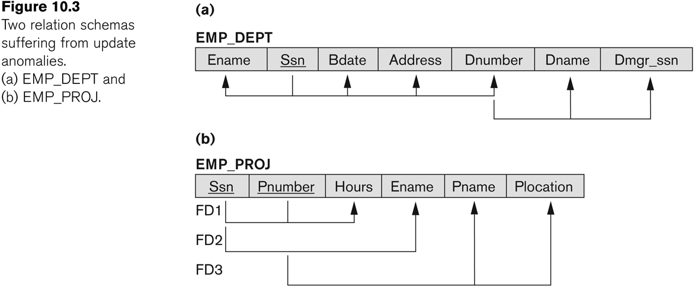
Two relation schemas suffering from update anomalies

Slide 13
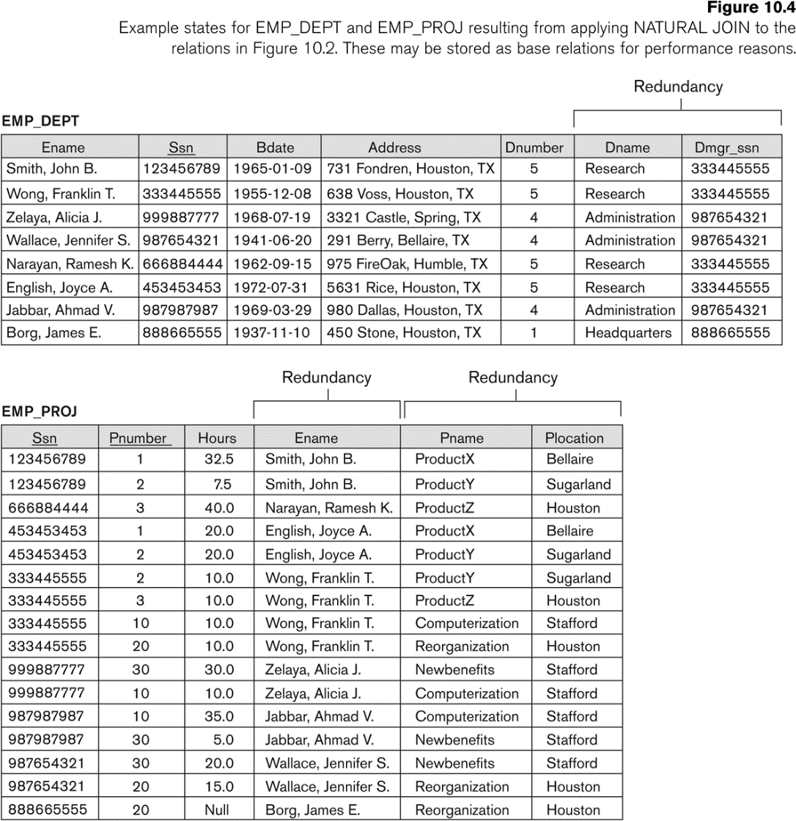
Base Relations EMP_DEPT and EMP_PROJ formed after a Natural Join : with redundant information

Slide 14
Guideline to Redundant Information in Tuples and Update Anomalies
GUIDELINE 2:
Design a schema that does not suffer from the insertion, deletion and update anomalies.
If there are any anomalies present, then note them so that applications can be made to take them into account.

Slide 15
1.3 Null Values in Tuples
GUIDELINE 3:
Relations should be designed such that their tuples will have as few NULL values as possible
Attributes that are NULL frequently could be placed in separate relations (with the primary key)
Reasons for nulls:
Attribute not applicable or invalid
Attribute value unknown (may exist)
Value known to exist, but unavailable

Slide 16
1.4 Spurious Tuples
Bad designs for a relational database may result in erroneous results for certain JOIN operations
The "lossless join" property is used to guarantee meaningful results for join operations
GUIDELINE 4:
The relations should be designed to satisfy the lossless join condition.
No spurious tuples should be generated by doing a natural-join of any relations.

Slide 17
Spurious Tuples (2)
There are two important properties of decompositions:
Non-additive or losslessness of the corresponding join
Preservation of the functional dependencies.
Note that:
Property (a) is extremely important and cannot be sacrificed.
Property (b) is less stringent and may be sacrificed. (See Chapter 11).

Slide 18
2.1 Functional Dependencies (1)
Functional dependencies (FDs)
Are used to specify formal measures of the "goodness" of relational designs
And keys are used to define normal forms for relations
Are constraints that are derived from the meaning and interrelationships of the data attributes
A set of attributes X functionally determines a set of attributes Y if the value of X determines a unique value for Y

Slide 19
Functional Dependencies (2)
X -> Y holds if whenever two tuples have the same value for X, they must have the same value for Y
For any two tuples t1 and t2 in any relation instance r(R): If t1[X]=t2[X], then t1[Y]=t2[Y]
X -> Y in R specifies a constraint on all relation instances r(R)
Written as X -> Y; can be displayed graphically on a relation schema as in Figures. ( denoted by the arrow: ).
FDs are derived from the real-world constraints on the attributes

Slide 20
Examples of FD constraints (1)
Social security number determines employee name
SSN -> ENAME
Project number determines project name and location
PNUMBER -> {PNAME, PLOCATION}
Employee ssn and project number determines the hours per week that the employee works on the project
{SSN, PNUMBER} -> HOURS

Slide 21
Examples of FD constraints (2)
An FD is a property of the attributes in the schema R
The constraint must hold on every relation instance r(R)
If K is a key of R, then K functionally determines all attributes in R
(since we never have two distinct tuples with t1[K]=t2[K])

Slide 22
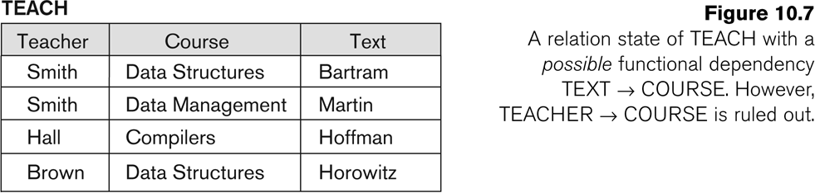
FD’s are a property of the meaning of data and hold at all times: certain FD’s can be ruled out based on a given state of the database

Slide 23
2.2 Inference Rules for FDs (1)
Given a set of FDs F, we can infer additional FDs that hold whenever the FDs in F hold
Armstrong's inference rules:
IR1. (Reflexive) If Y subset-of X, then X -> Y
IR2. (Augmentation) If X -> Y, then XZ -> YZ
(Notation: XZ stands for X U Z)
IR3. (Transitive) If X -> Y and Y -> Z, then X -> Z
IR1, IR2, IR3 form a sound and complete set of inference rules
These are rules hold and all other rules that hold can be deduced from these

Slide 24
Inference Rules for FDs (2)
Some additional inference rules that are useful:
Decomposition: If X -> YZ, then X -> Y and X -> Z
Union: If X -> Y and X -> Z, then X -> YZ
Pseudotransitivity: If X -> Y and WY -> Z, then WX -> Z
The last three inference rules, as well as any other inference rules, can be deduced from IR1, IR2, and IR3 (completeness property)

Slide 25
Inference Rules for FDs (3)
Closure of a set F of FDs is the set F⁺ of all FDs that can be inferred from F
Closure of a set of attributes X with respect to F is the set X⁺ of all attributes that are functionally determined by X
X⁺ can be calculated by repeatedly applying IR1, IR2, IR3 using the FDs in F

Slide 26
2.3 Equivalence of Sets of FDs
Two sets of FDs F and G are equivalent if:
Every FD in F can be inferred from G, and
Every FD in G can be inferred from F
Hence, F and G are equivalent if F⁺ =G⁺
Definition (Covers):
F covers G if every FD in G can be inferred from F
(i.e., if G⁺ subset-of F⁺)
F and G are equivalent if F covers G and G covers F
There is an algorithm for checking equivalence of sets of FDs

Slide 27
2.4 Minimal Sets of FDs (1)
A set of FDs is minimal if it satisfies the following conditions:
Every dependency in F has a single attribute for its RHS.
We cannot remove any dependency from F and have a set of dependencies that is equivalent to F.
We cannot replace any dependency X -> A in F with a dependency Y -> A, where Y proper-subset-of X ( Y subset-of X) and still have a set of dependencies that is equivalent to F.

Slide 28
Minimal Sets of FDs (2)
Every set of FDs has an equivalent minimal set
There can be several equivalent minimal sets
There is no simple algorithm for computing a minimal set of FDs that is equivalent to a set F of FDs
To synthesize a set of relations, we assume that we start with a set of dependencies that is a minimal set
E.g., see algorithms 11.2 and 11.4

Slide 29
Computing the Minimal Sets of FDs
We illustrate the above algorithm with the following:
Let the given set of FDs be E : {B → A, D → A, AB → D}.We have to find the minimum
cover of E.
■ All above dependencies are in canonical form; so we have completed step 1
of Algorithm 10.2 and can proceed to step 2. In step 2 we need to determine
if AB → D has any redundant attribute on the left-hand side; that is, can it be
replaced by B → D or A → D?
■ Since B → A, by augmenting with B on both sides (IR2), we have BB → AB, or
B → AB (i). However, AB → D as given (ii).
■ Hence by the transitive rule (IR3), we get from (i) and (ii), B → D. Hence
AB → D may be replaced by B → D.
■ We now have a set equivalent to original E , say E′ : {B → A, D → A, B → D}.
No further reduction is possible in step 2 since all FDs have a single attribute
on the left-hand side.
■ In step 3 we look for a redundant FD in E′. By using the transitive rule on
B → D and D → A, we derive B → A. Hence B → A is redundant in E’ and can
be eliminated.
■ Hence the minimum cover of E is {B → D, D → A}.

